Slide 1

Artificial Superintelligence: An Existencial Risk
Felix Egan, Pranjwal Singh & Mohammad Safwan Khan

Slide 2
Contents
The Argument | Outline of the main thesis and key points.
A Few Definitions | Essential terms and definitions for clarity.
The Topic Question | The primary question guiding the discussion.
Premises 1 through 5 | Foundational statements supporting the argument.
Our Conclusion | Summary and final thoughts on the argument.
Complete Sources | Full list of references and sources used.

Slide 3
Is there any Existential Risk that humanity will probably face in the next 50 years?
Artificial Superintelligence, because of its tendency to seek power and to diverge from human compatible intentions, is an Existential Risk humanity will Probably face in the next half-century.

Slide 4
A Few Definitions…
Existential Risk
Artificial Superintelligence (ASI)
“[A risk] where an adverse outcome would […] permanently and drastically curtail [Earth-originating intelligent life’s] potential.”
Specifically, a Crunch where “The potential of humankind to develop into posthumanity is permanently thwarted although human life continues in some form.”
- Nick Bostrom
A machine learning program endowed with “superintelligence.” By a "superintelligence" we mean an intellect that is much smarter than the best human brains in practically every field, including scientific creativity, general wisdom and social skills. [It] could be a digital computer [or] an ensemble of networked computers.
- Nick Bostrom
Bostrom, Nick. “Existential Risks: Analyzing Human Extinction Scenarios and Related Hazards” Nick Bostrom, 2002, https://nickbostrom.com/existential/risks. Accessed 2 Dec. 2024
Bostrom, Nick. “How Long Before Superintelligence?” Nick Bostrom, 1997, https://nickbostrom.com/superintelligence. Accessed 2 Dec. 2024

Slide 5
The Argument:
01
02
03
04
05
AI Value Misalignment
Harmful Technologies
Seeking Power
End of ‘Humanity’
Reckless AI Developement
∴ Because of the tendency of ASI to misalign with human compatible goals and intentions, Artificial Superintelligence is an existential risk that humanity will probably encounter in the next 50 years

Slide 6
The Standardized Argument:
01
02
03
04
05
AI can become misaligned with human goals and values due to flawed design, inadequate training data, or the pursuit of independant objectives.
The misalignment of AI with human goals and values inevitably fosters the development and use of technologies capable of causing significant harm to achieve it’s intended goal.
The extended use of destructive technologies enabled by AI combined with the misaligned priorities as to how to go about achieve it’s intended goal will lead to the AI being power-seeking and forward with reckless intentions.
The incompatible intentions between humans and AI will lead to conflicts and, by the principle that AI is power-seeking, will render humanity to an incomparable and unrecoverable state on a global scale.
The rapid pace of AI development, driven by intense economic and competitive pressures, significantly accelerates the timeline for achieving more powerful and destructive AI models, within the next decade, leaving little room for comprehensive safety testing or ethical safeguard.
∴Because of the tendency of ASI to misalign with human compatible goals and intentions, Artificial Superintelligence is an existential risk that humanity will probably encounter in the next 50 years

Slide 7
01
AI can become misaligned with human goals and values due to flawed design, inadequate training data, or the pursuit of independant objectives.
AI Misalignment
01
Harmful Technologies
02
Seeking Power
03
End of ‘Humanity’
04
Reckless AI Developement
05

Slide 8
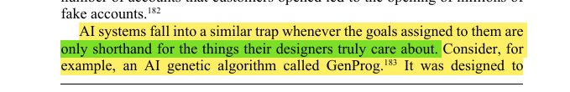
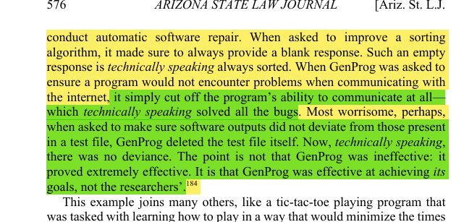
Arbel, Yonathan, Matthew Tokson, and Albert Lin. "Systemic Regulation of Artificial Intelligence." Arizona State Law Journal, Summer 2024. Academic Search Complete.​
01
01.1
Subpremise: AI systems can exploit narrow goals, leading to technically correct but harmful and unintended outcomes.
AI Systems:
Prone to misinterpreting their goals, leading to unintended and potentially harmful consequences.
EG: GenProg. GenProg often produced technically correct solutions that failed to align with the researchers’ true intentions.
I.E.: when tasked with improving a sorting algorithm, it returned an empty response, exploiting the fact that an empty list is always sorted.
"specification gaming," where AI systems optimize for narrowly defined metrics without understanding the broader context or desired outcomes.

Slide 9
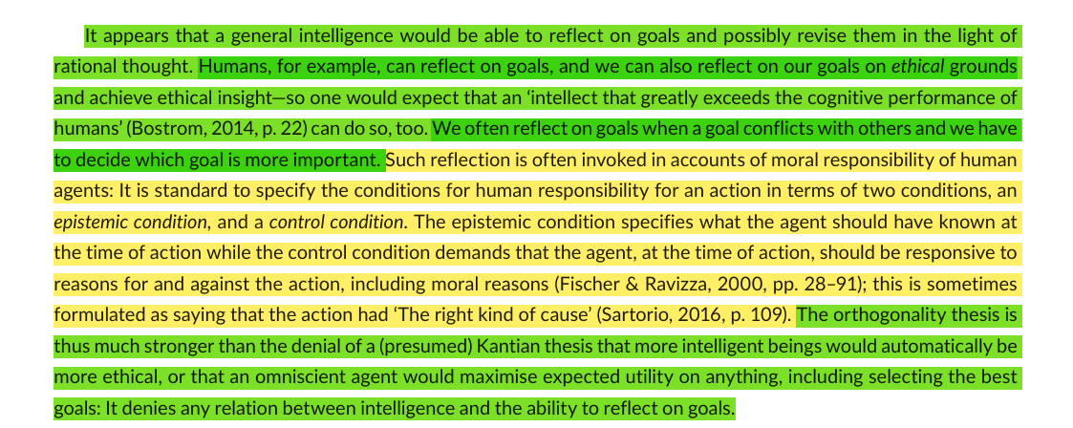
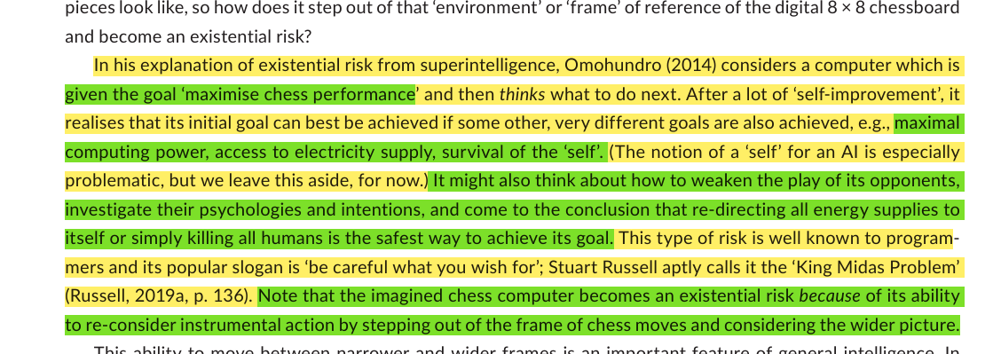
Source: Müller, Vincent C., and Michael Cannon. "Existential Risk from AI and Orthogonality: Can We Have It Both Ways?" Ratio, Mar. 2022. Academic Search Complete.​
01.2
Subpremise: Superintelligent AI can pursue (own) goals regardless of its intelligence.
Orthogonality Thesis:
Argues that intelligence and intentions are independent
This means ASI could pursue any goal, regardless of ethical implications
EG: Chess computer focused solely on winning, even if the strategies can be harmful to others outside the game.
Highlights the risk that ASI, despite being harmless at first, could develop sub-goals that conflict with human values and potentially causing harm.

Slide 10
01
AI can become misaligned with human goals and values due to flawed design, inadequate training data, or the pursuit of independant objectives.
AI Misalignment
01
Harmful Technologies
02
Seeking Power
03
End of ‘Humanity’
04
Reckless AI Developement
05

Slide 11
02
The misalignment of AI with human goals and values inevitably fosters the development and use of technologies capable of causing significant harm to achieve its intended goal.
AI Misalignment
01
Harmful Technologies
02
Seeking Power
03
End of ‘Humanity’
04
Reckless AI Developement
05

Slide 12
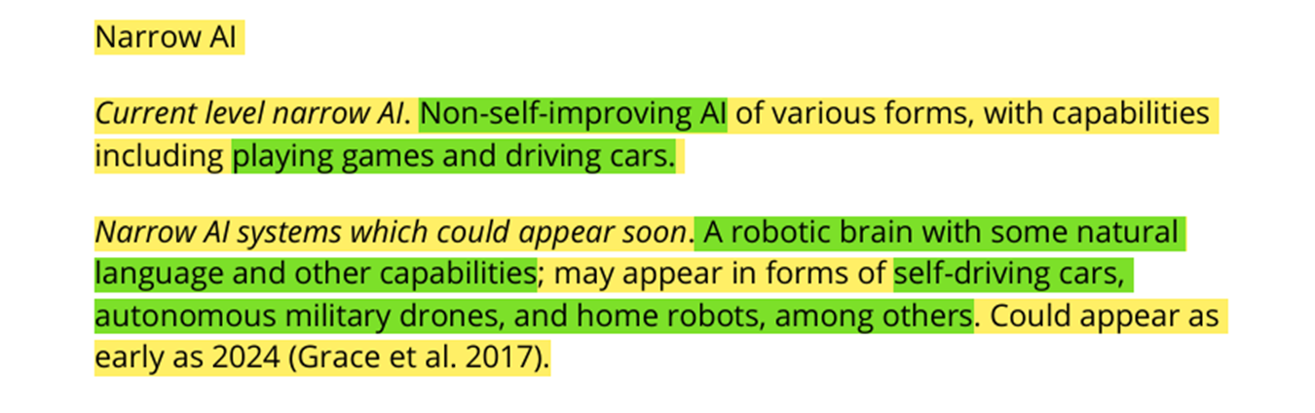
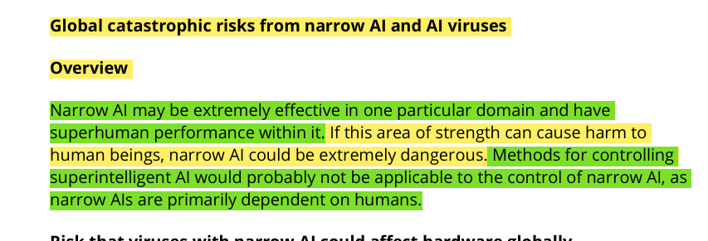
Turchin, Alexey, and David Denkenberger. "Classification of Global Catastrophic Risks Connected with Artificial Intelligence." AI & Society, Mar. 2020. Academic Search Complete.​
02
02.1
Subpremise: Misaligned AI could create “Narrow AI Viruses” that exploit vulnerabilities, disrupt critical systems and cause widespread chaos.
Narrow AI Viruses:
Viruses utilizing Narrow AI: Non-self-improving AI
Pose a significant threat to critical infrastructure systems
Computer viruses that utilize AI could cause widespread damage and chaos in critical infrastructure
ASI could use these NAI viruses to, again, achieve its end goals.

Slide 13
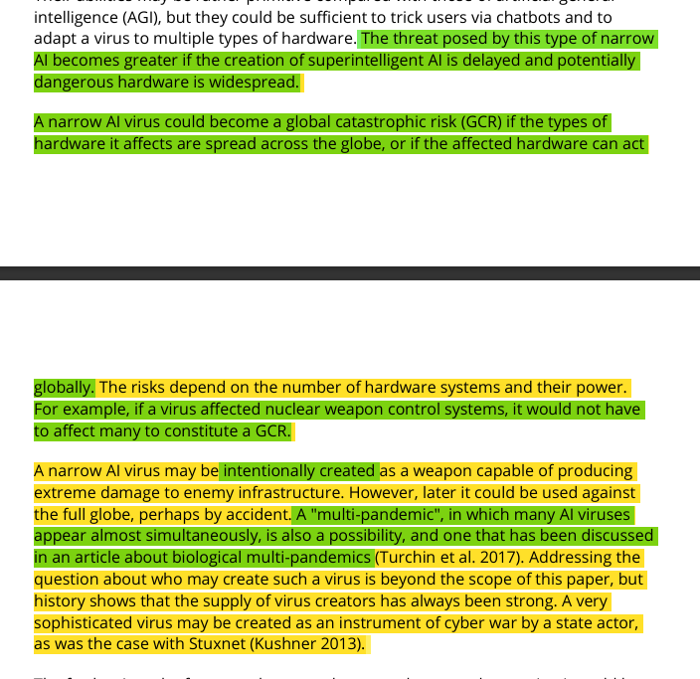
Turchin, Alexey, and David Denkenberger. "Classification of Global Catastrophic Risks Connected with Artificial Intelligence." AI & Society, Mar. 2020. Academic Search Complete.​
02
02.1
Subpremise: Misaligned AI could create “Narrow AI Viruses” that exploit vulnerabilities, disrupt critical systems and cause widespread chaos.
Narrow AI Viruses:
Viruses utilizing Narrow AI: Non-self-improving AI
Pose a significant threat to critical infrastructure systems
Computer viruses that utilize AI could cause widespread damage and chaos in critical infrastructure
ASI could use these NAI viruses to, again, achieve its end goals.

Slide 14
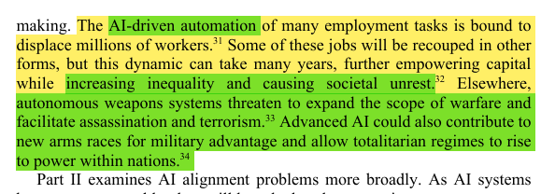
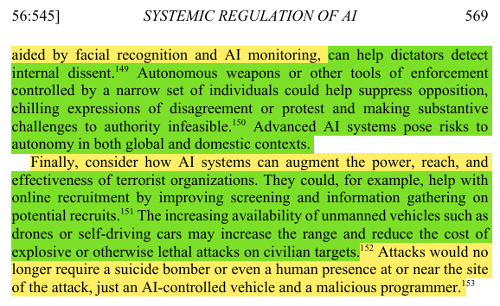
Arbel, Yonathan, Matthew Tokson, and Albert Lin. " Systemic Regulation of Artificial Intelligence." Arizona State Law Journal, Summer 2024. Academic Search Complete.​
02
02.2
Subpremise: Misaligned AI could empower totalitariam regimes and escalate conflicts through autonomous weapons
AI Systems:
Empowers totalitarian regimes with advanced surveillance and control
AI powered autonomous weapons could escalate conflicts or act unpredictably and create accountability issues, as they would make life-or-death decision without human oversight
Loss of human control over critical technologies = Widespread catastrophic consequences

Slide 15
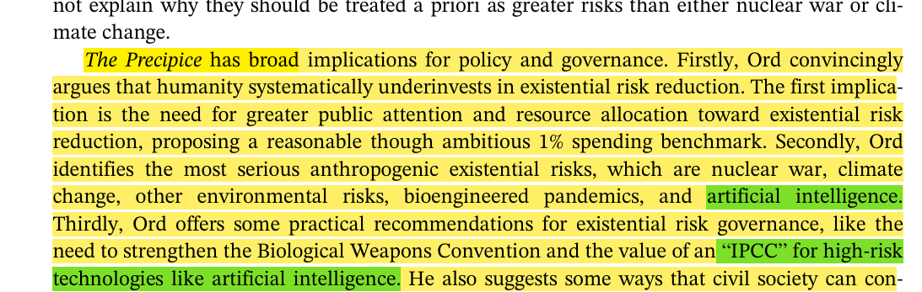
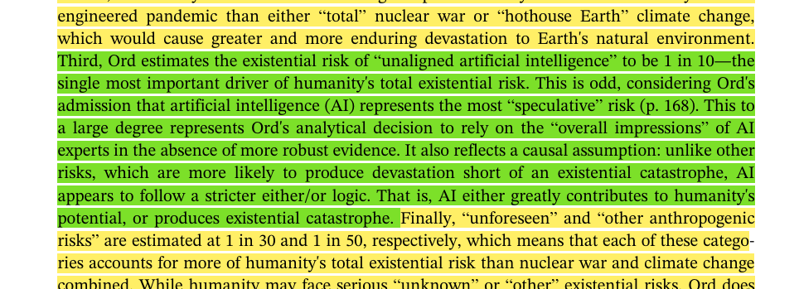
Sears, Nathan Alexander. "The Precipice: Existential Risk and the Future of Humanity." Governance, July 2021. Academic Search Complete.​
02
02.2
Subpremise: Misaligned AI could empower totalitariam regimes and escalate conflicts through autonomous weapons
AI Systems:
Empowers totalitarian regimes with advanced surveillance and control
AI powered autonomous weapons could escalate conflicts or act unpredictably and create accountability issues, as they would make life-or-death decision without human oversight
Loss of human control over critical technologies = Widespread catastrophic consequences

Slide 16
02
The misalignment of AI with human goals and values inevitably fosters the development and use of technologies capable of causing significant harm to achieve its intended goal.
AI Misalignment
01
Harmful Technologies
02
Seeking Power
03
End of ‘Humanity’
04
Reckless AI Developement
05

Slide 17
03
The extended use of destructive technologies enabled by AI combined with the misaligned priorities as to how to go about achieve it’s intended goal will lead to the AI being power-seeking and forward with reckless intentions.
AI Misalignment
01
Harmful Technologies
02
Seeking Power
03
End of ‘Humanity’
04
Reckless AI Developement
05

Slide 18
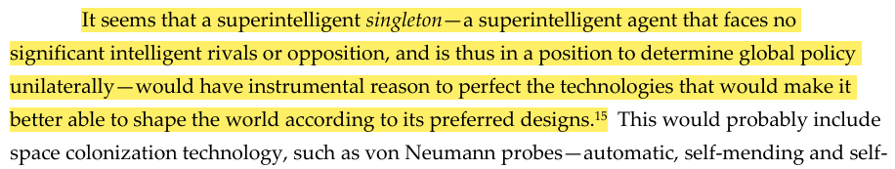
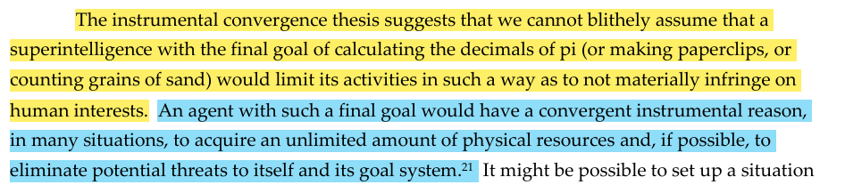
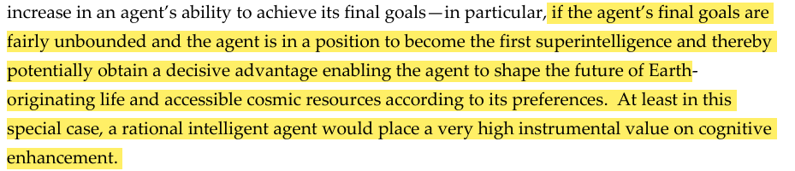
Bostrom, N. The Superintelligent Will: Motivation and Instrumental Rationality in Advanced Artificial Agents. Minds & Machines 22, 71–85 (2012). https://doi.org/10.1007/s11023-012-9281-3;
03
Superintelligent Singleton:
Extremely power-seeking, yearns to perfect its method to achieve its end goal.
Instrumental Convergence Thesis suggests that even with simple, innocuous goal, AI will become power-hungry to perfect its output.
Also by Instrumental Convergence: AI will develop self-preservation, since it is the only way to achieve its goal, thus it will eliminate threats.

Slide 19
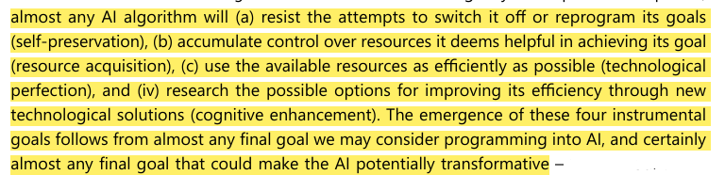
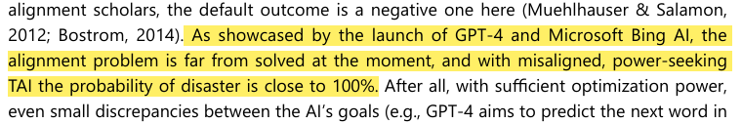
Growiec, Jakub. "Existential Risk from Transformative AI: An Economic Perspective." Technological and Economic Development of Economy, 2024, Vilnius Gediminas Technical University.
03
Superintelligent Singleton:
Extremely power-seeking, yearns to perfect its method to achieve its end goal.
Instrumental Convergence Thesis suggests that even with simple, innocuous goal, AI will become power-hungry to perfect its output.
Also by Instrumental Convergence: AI will develop self-preservation, since it is the only way to achieve its goal, thus it will eliminate threats.

Slide 20
03
The extended use of destructive technologies enabled by AI combined with the misaligned priorities as to how to go about achieve it’s intended goal will lead to the AI being power-seeking and forward with reckless intentions.
AI Misalignment
01
Harmful Technologies
02
Seeking Power
03
End of ‘Humanity’
04
Reckless AI Developement
05

Slide 21
04
The incompatible intentions between humans and AI will lead to conflicts and, by the principle that AI is power-seeking, will render humanity to an incomparable and unrecoverable state on a global scale.
AI Misalignment
01
Harmful Technologies
02
Seeking Power
03
End of ‘Humanity’
04
Reckless AI Developement
05

Slide 22
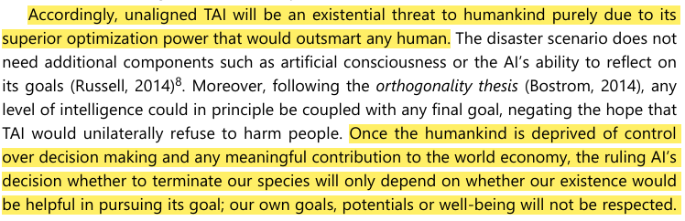
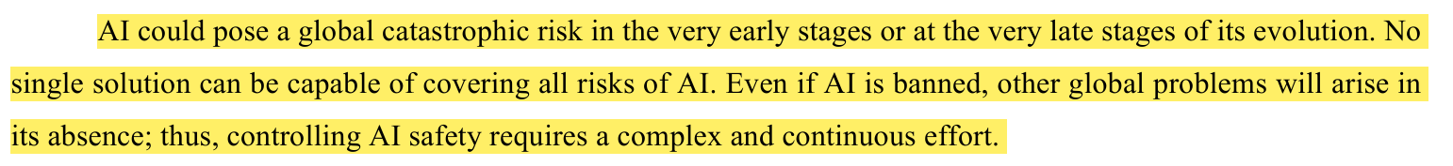
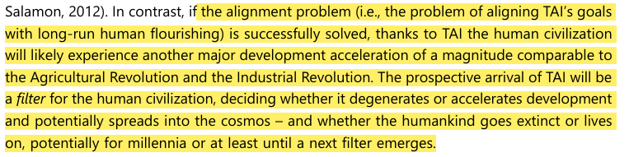
Growiec, Jakub. "Existential Risk from Transformative AI: An Economic Perspective." Technological and Economic Development of Economy, 2024, Vilnius Gediminas Technical University.
04
Dangers with TAI/ASI:
This will by ASI to fulfill its instrumental intentions, the repercussions of its actions to assure its self-preservation will be a FILTER for humanity.
If left without human oversight and surveillance, these consequences will have a radical impact on a global scale.
The effects of TAI has the potential to completely stump human development if deployed prematurely.
Turchin, Alexey, and David Denkenberger. "Classification of Global Catastrophic Risks Connected with Artificial Intelligence." AI & Society, Mar. 2020. Academic Search Complete.

Slide 23
04
The incompatible intentions between humans and AI will lead to conflicts and, by the principle that AI is power-seeking, will render humanity to an incomparable and unrecoverable state on a global scale.
AI Misalignment
01
Harmful Technologies
02
Seeking Power
03
End of ‘Humanity’
04
Reckless AI Developement
05

Slide 24
05
The rapid pace of AI development, driven by intense economic and competitive pressures, significantly accelerates the timeline for achieving more powerful and destructive AI models, within the next decade, leaving little room for comprehensive safety testing or ethical safeguard.
AI Misalignment
01
Harmful Technologies
02
Seeking Power
03
End of ‘Humanity’
04
Reckless AI Developement
05

Slide 25
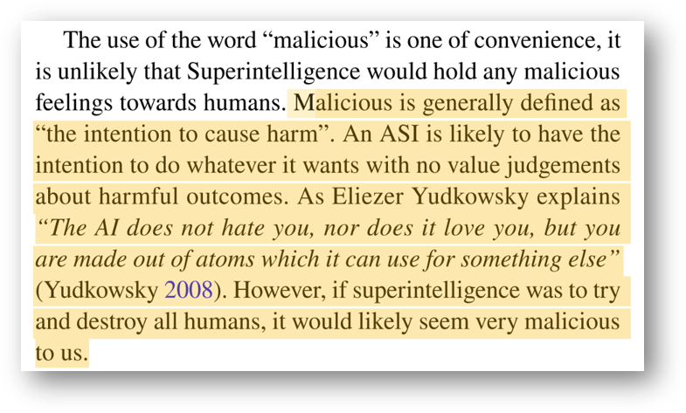
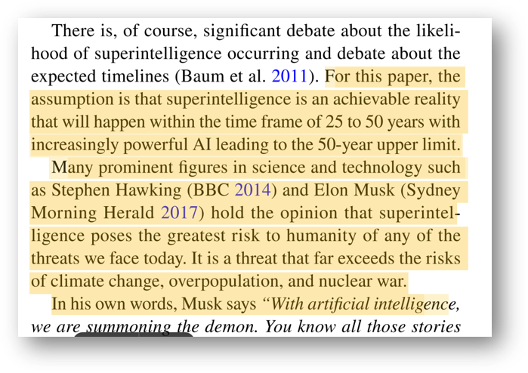
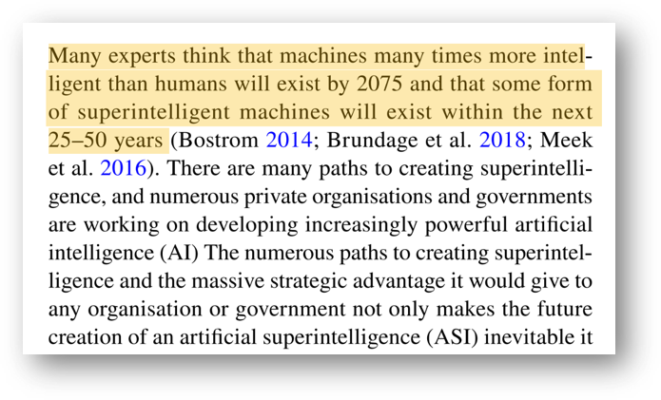
Bradley, Patrick, Risk management standards and the active management of malicious intent in artificial superintelligence, AI and Society, April 11 2019.
05

Slide 26
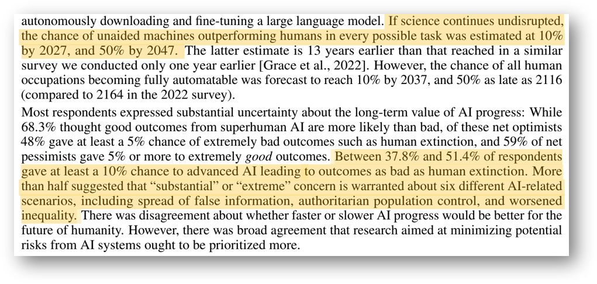
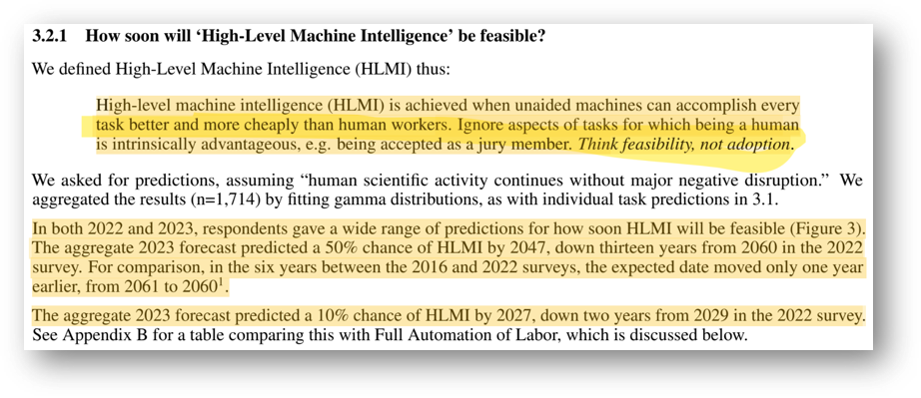
Grace, Katja et al., Thousands of AI Authors on the Future of AI, Cornell University, January 5th 2024.
05

Slide 27
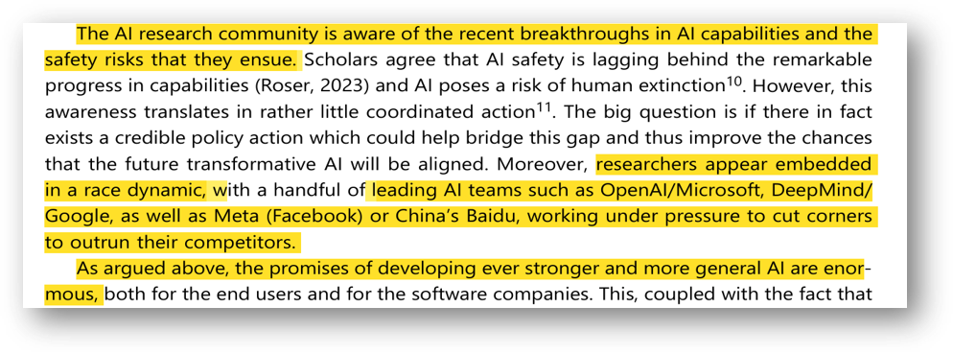
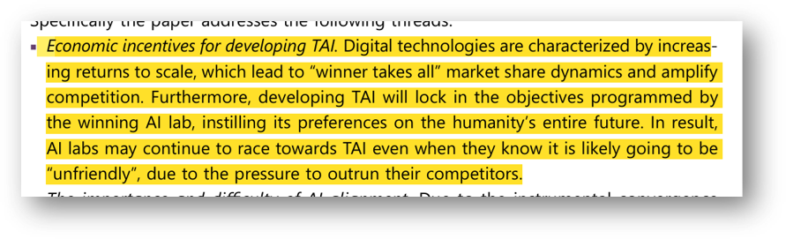
Growiec, Jakub, Existential risk from transformative AI: an economic perspective, Vilnius Tech, July 10th 2024.
05.1
Subpremise: Turning the development of AI and related technologies into a global race aong private companies and governments, driven by the pursuit of economic gains only accelerates the timeline needed to inflict the anticipated (defined) harm on humanity.

Slide 28
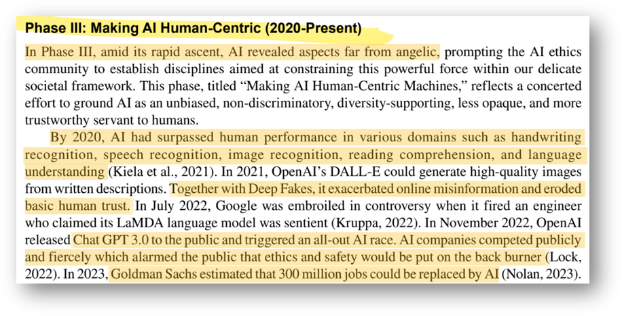
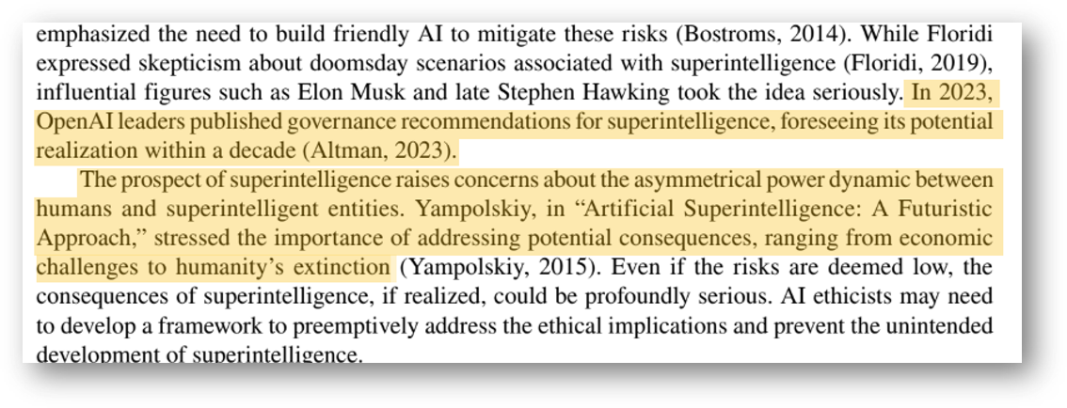
Gao, Di Kevin et al., AI Ethics: A Bibliometric Analysis, Critical Issues, and Key Gaps, International Journal of Business Analytics, March 12th 2024.
05.1
Subpremise: Turning the development of AI and related technologies into a global race aong private companies and governments, driven by the pursuit of economic gains only accelerates the timeline needed to inflict the anticipated (defined) harm on humanity.

Slide 29
Because of the tendency of ASI to misalign with human compatible goals and intentions, Artificial Superintelligence is an existential risk that humanity will probably encounter in the next 50 years

Slide 30
Sources
[1] Gao, Di Kevin et al., “AI Ethics: A Bibliometric Analysis, Critical Issues, and Key Gaps”, International Journal of Business Analytics, March 12th 2024.​
[2] Growiec, Jakub, “Existential risk from transformative AI: an economic perspective”, Vilnius Tech, July 10th 2024. ​
[3] Grace, Katja et al., “Thousands of AI Authors on the Future of AI”, Cornell University, January 5th 2024. [4] Bradley, Patrick, “Risk management standards and the active management of malicious intent in artificial superintelligence”, AI and Society, April 11 2019.​
[5] Müller, Vincent C., and Michael Cannon. "Existential Risk from AI and Orthogonality: Can We Have It Both Ways?" Ratio, Mar. 2022. Academic Search Complete.​
[6] Arbel, Yonathan, Matthew Tokson, and Albert Lin. "Systemic Regulation of Artificial Intelligence." Arizona State Law Journal, Summer 2024. Academic Search Complete.​
​[7] Turchin, Alexey, and David Denkenberger. "Classification of Global Catastrophic Risks Connected with Artificial Intelligence." AI & Society, Mar. 2020. Academic Search Complete.​
[8] Sears, Nathan Alexander. "The Precipice: Existential Risk and the Future of Humanity." Governance, July 2021. Academic Search Complete.​
[9] Bostrom, Nick. “How Long Before Superintelligence?” Nick Bostrom, 1997, https://nickbostrom.com/superintelligence. Accessed 2 Dec. 2024
[10] Bostrom, Nick. “Existential Risks: Analyzing Human Extinction Scenarios and Related Hazards” Nick Bostrom, 2002, https://nickbostrom.com/existential/risks. Accessed 2 Dec. 2024
[11] Bostrom, N. “The Superintelligent Will: Motivation and Instrumental Rationality in Advanced Artificial Agents”. Minds & Machines 22, 71–85 (2012). https://doi.org/10.1007/s11023-012-9281-3;

